Slide 1


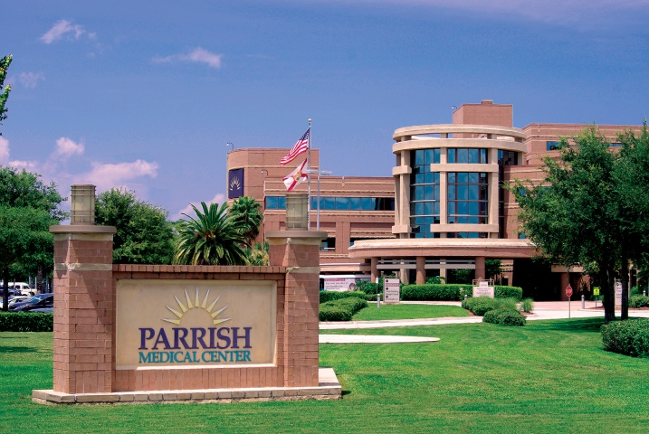
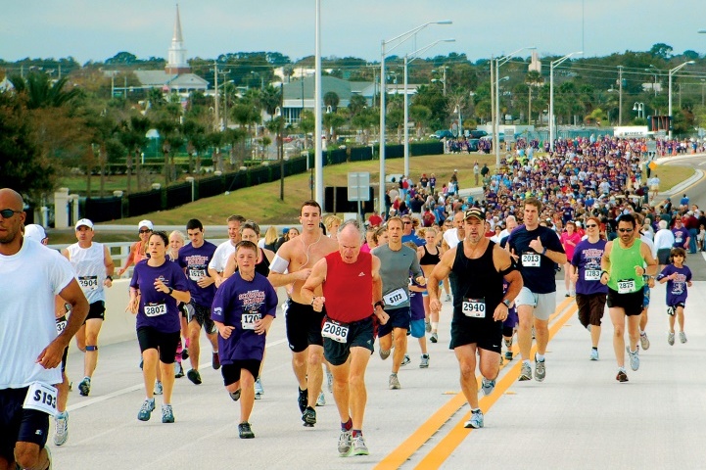
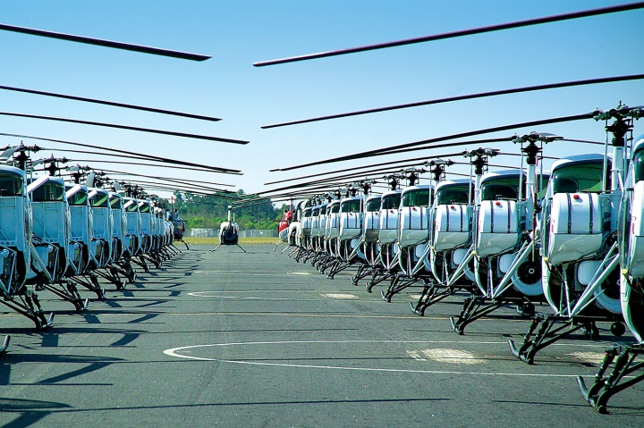

Slide 2


Downtown Titusville CRA Grants
Beautification Grant
Interior Building Renovation Incentive Grant
Permit & Impact Fee Incentive Grant
Economic Development Department -2-
Notes:
Commercial Beautification (Façade) Grant
Maximum $40,000 Matching Grant
Eligible items include
Signage
Addition and/or replacement of awnings/doors/windows
New Stucco
Landscaping and irrigation
Outdoor safety lighting
Roof repair and improvements
parking facilities
stormwater enhancements
decorative fencing
etc.
Commercial Interior Building Renovation Incentive Grant
Maximum $50,000 Matching Grant for Commercial Buildings
Maximum $100,000 Matching Grant for Commercial Mixed Use Buildings
Eligible items include:
ADA Requirements
Florida Fire Protection Code Requirements
Florida Building Code Requirements including:
Interior plumbing to meet code
Interior electrical system including lighting to meet code
HVAC system to meet code
Applicant can be owner or tenant with owner permission.
Two (2) cost estimates with application required. The lowest cost estimate used however the low bidder doesn’t have to be used.

Slide 3
Downtown Titusville CRA
Application Process Summary
JUST CALL SUE
Sue Williams (321)567-3860 or sue.williams@titusville.com

Slide 4
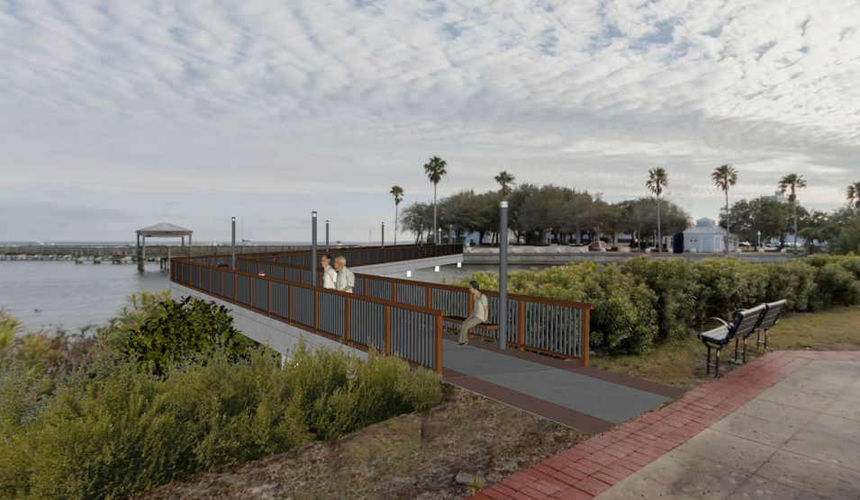
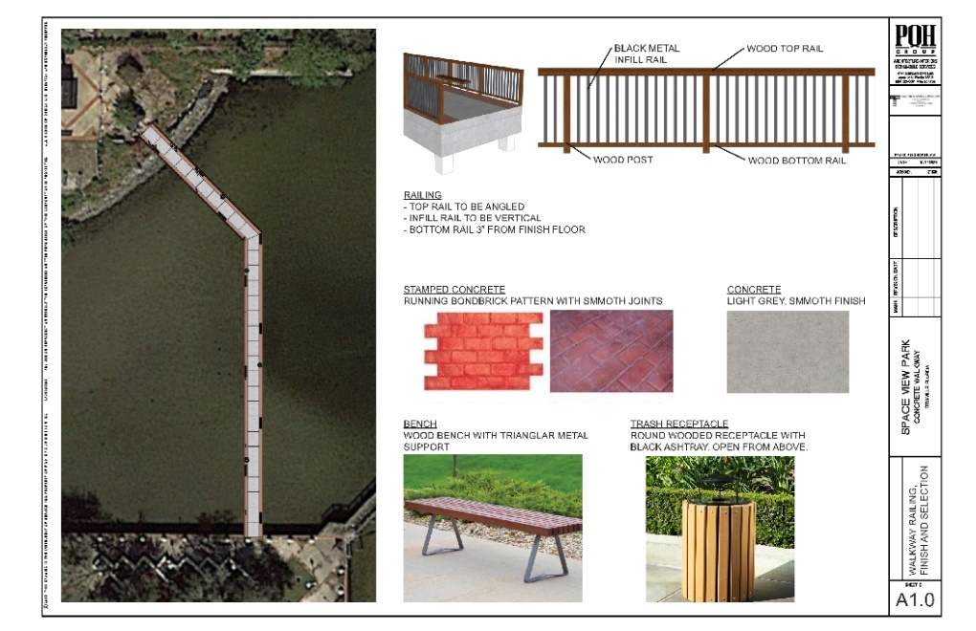
Downtown Development Update
Spaceview Park Connecting Pedestrian Pier Park

Slide 5
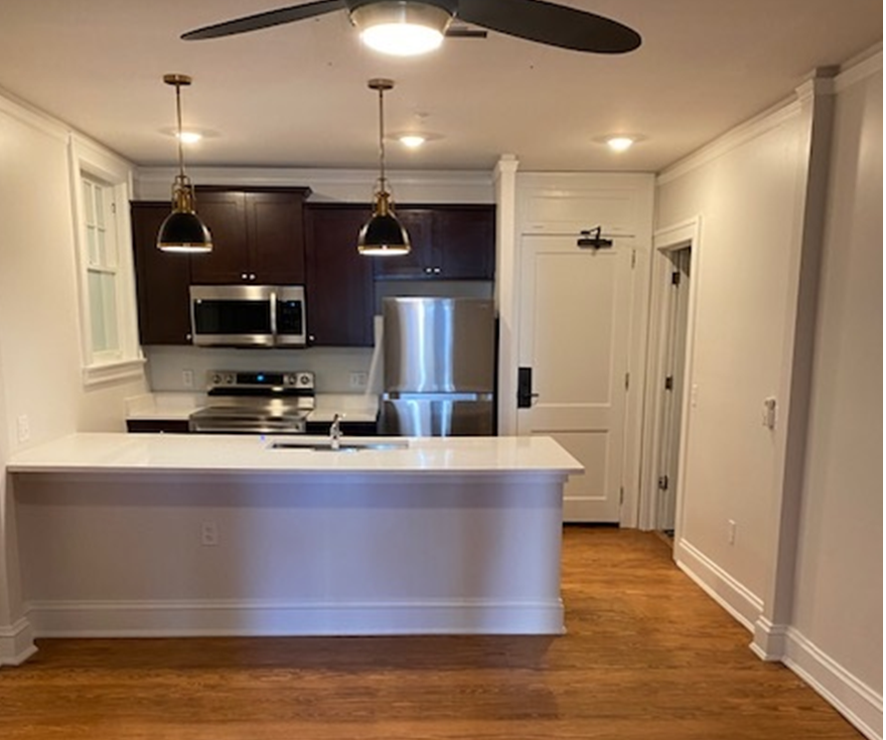
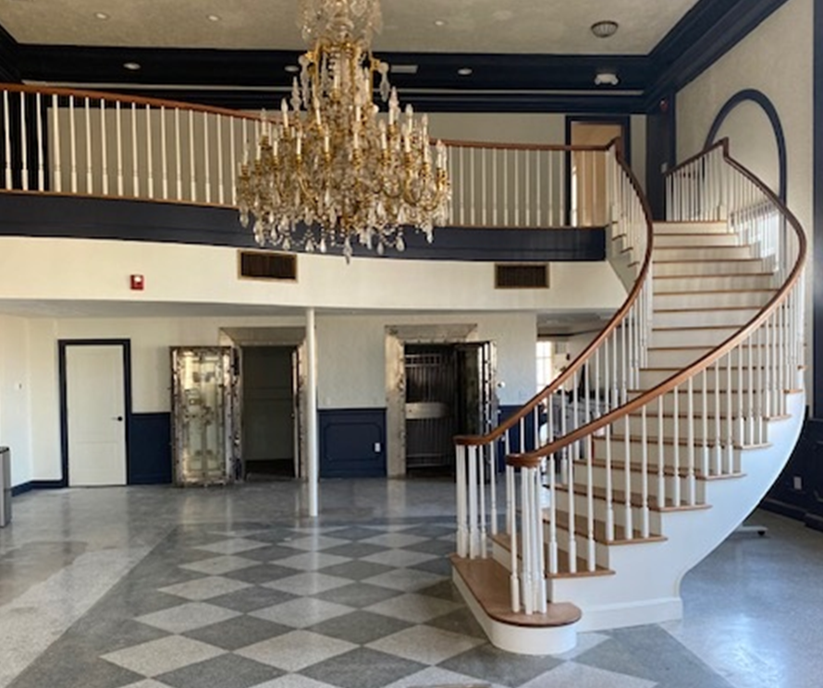
Downtown Development Update
Launch Now

Slide 6
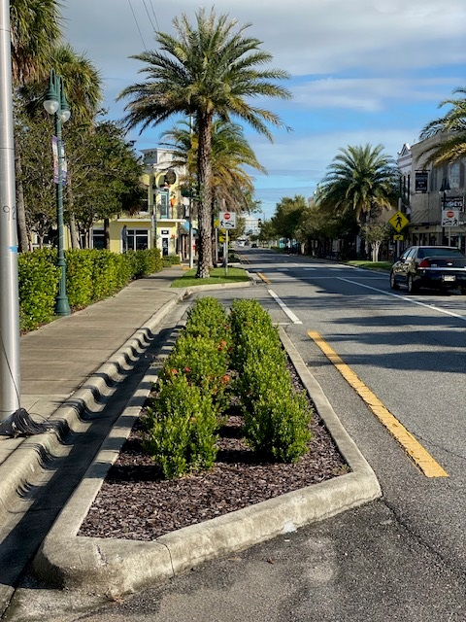
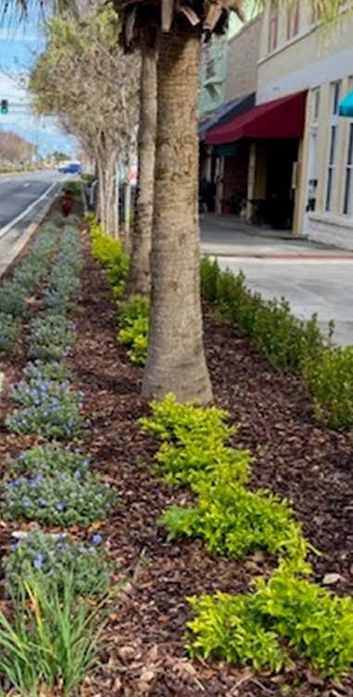
Downtown Development Update
Additional US-1 and Intersections Landscape

Slide 7
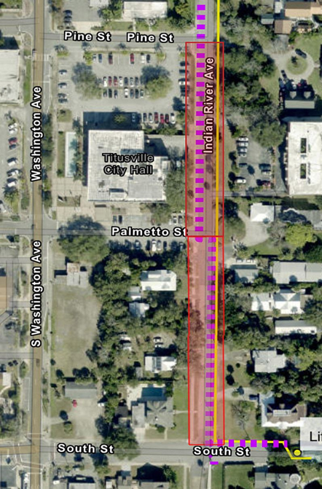
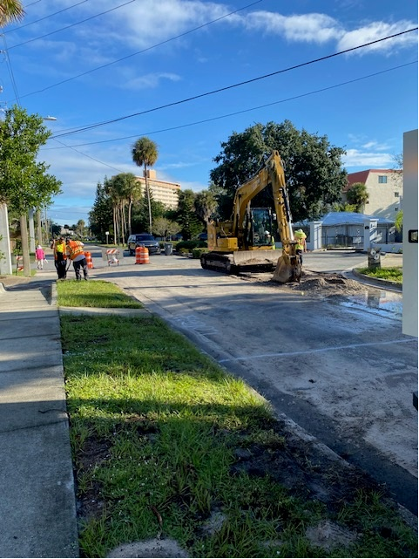
Downtown Development Update
Indian River Force Main Infrastructure Improvements

Slide 8
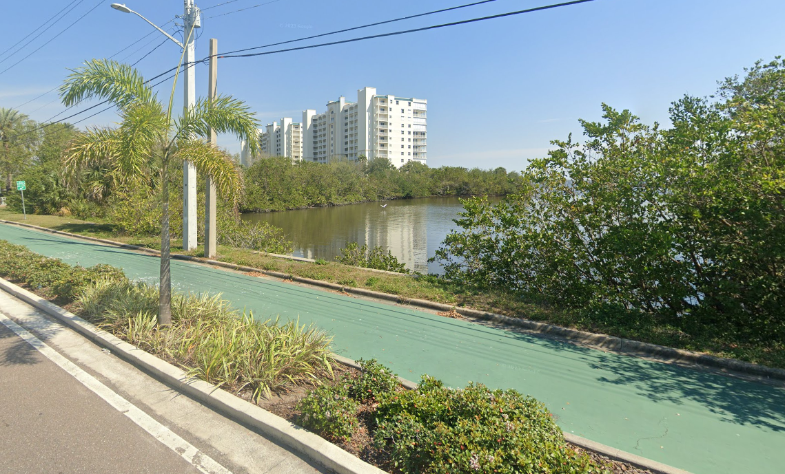
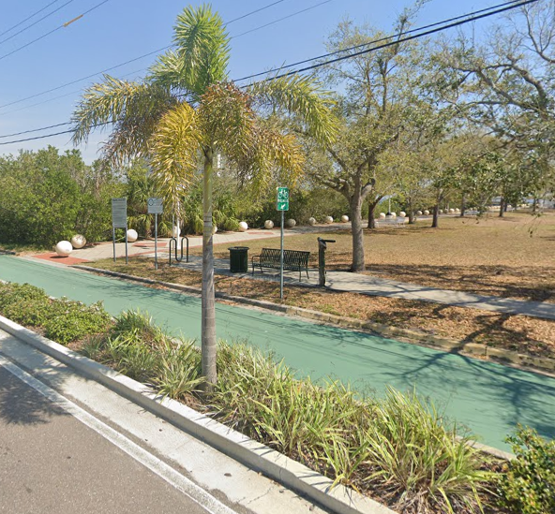
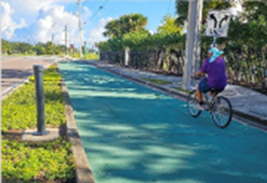
Downtown Development Update
Installation of Pedestrian and Bicycle counter on Indian River

Slide 9
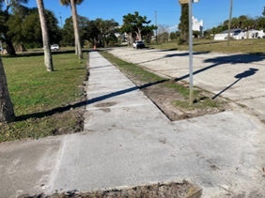
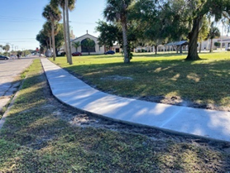
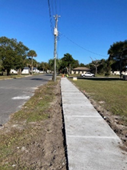
Downtown Development Update
Sidewalk Infill

Slide 10
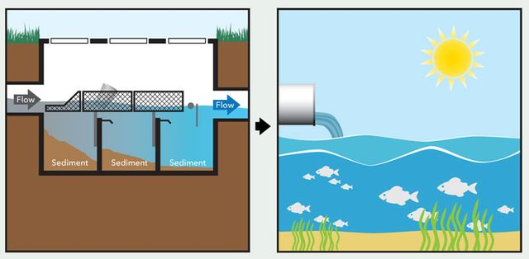
Downtown Development Update
Sand Point Park Baffle Box

Slide 11
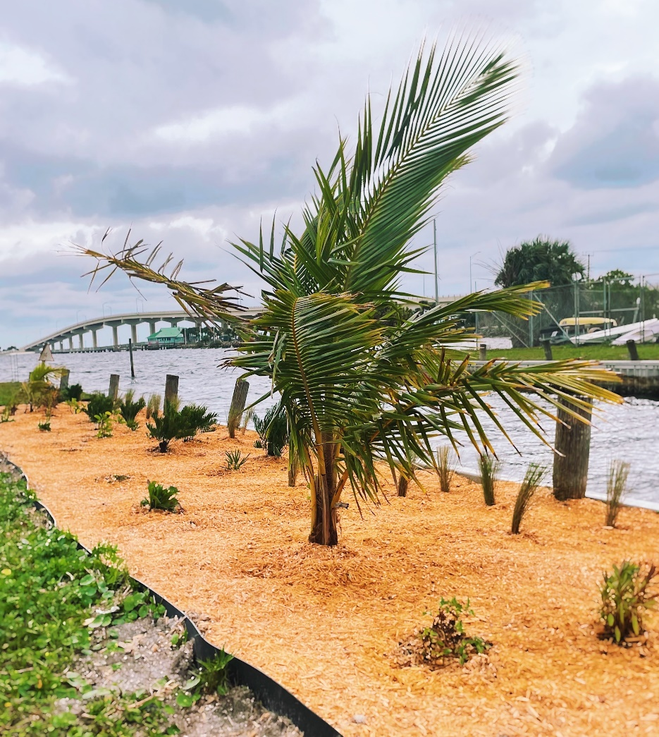
Downtown Development Update
Native Vegetation Buffer Zone at Sand Point Park

Slide 12
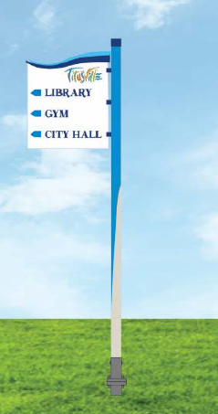

Downtown Development Update
Branding Wayfinding Signs

Slide 13
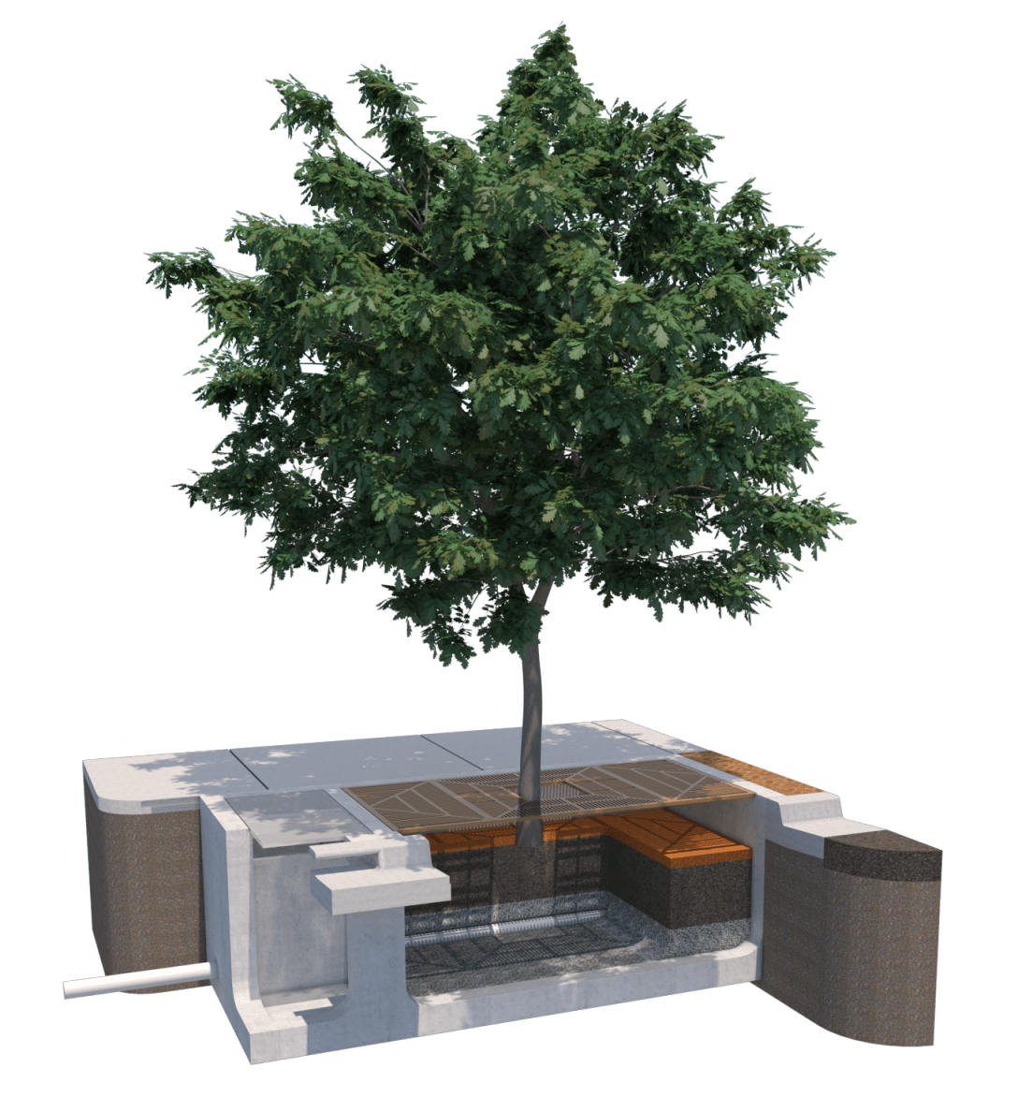
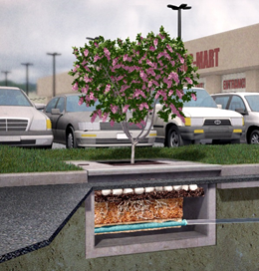
Downtown Development Update
Tree Box Filters

Slide 14
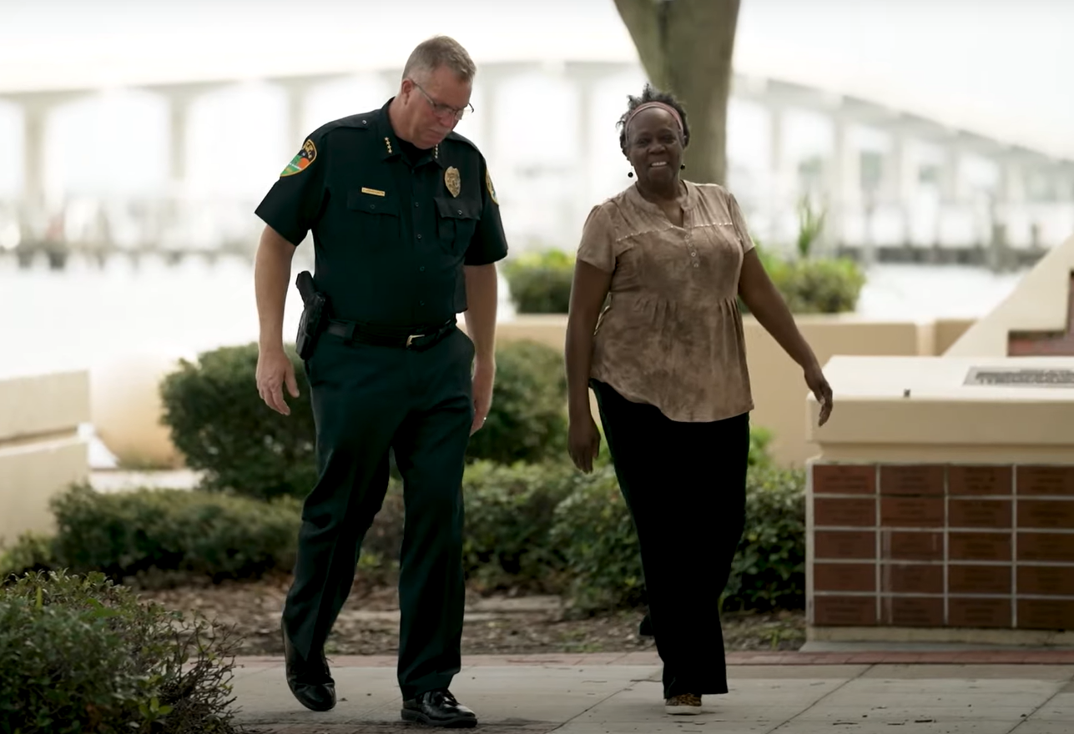
Downtown Development Update
Community Policing

Slide 15
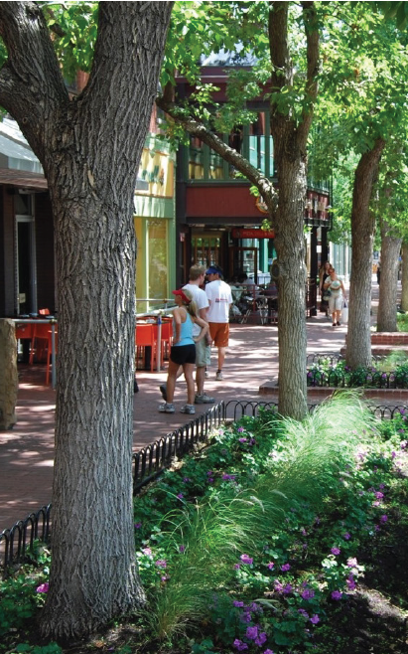
Downtown Goals
Create a sense of place and memorable identity
Make Downtown more walkable and bike-friendly with variety of traffic calming options and a multimodal trail network(s)
Integrate more attractive green park spaces for community events
Generate more activity and residential population to help existing and new businesses grow and thrive

