Slide 1



2040 Comprehensive Plan
Planning and Zoning Commission

Slide 2
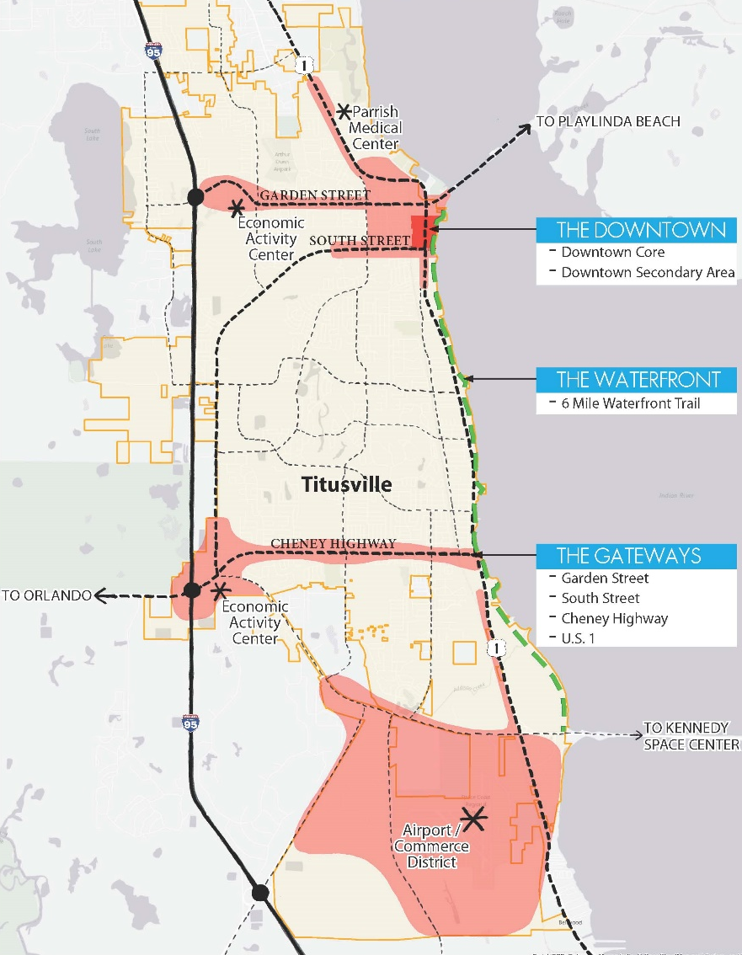
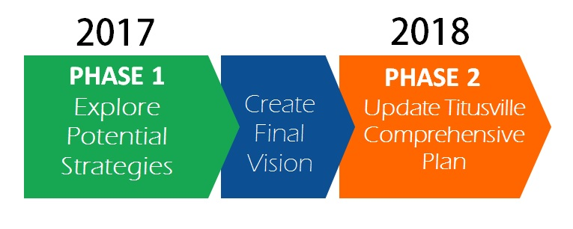

3 Keys to the Vision
3 Keys to the Vision

Slide 3
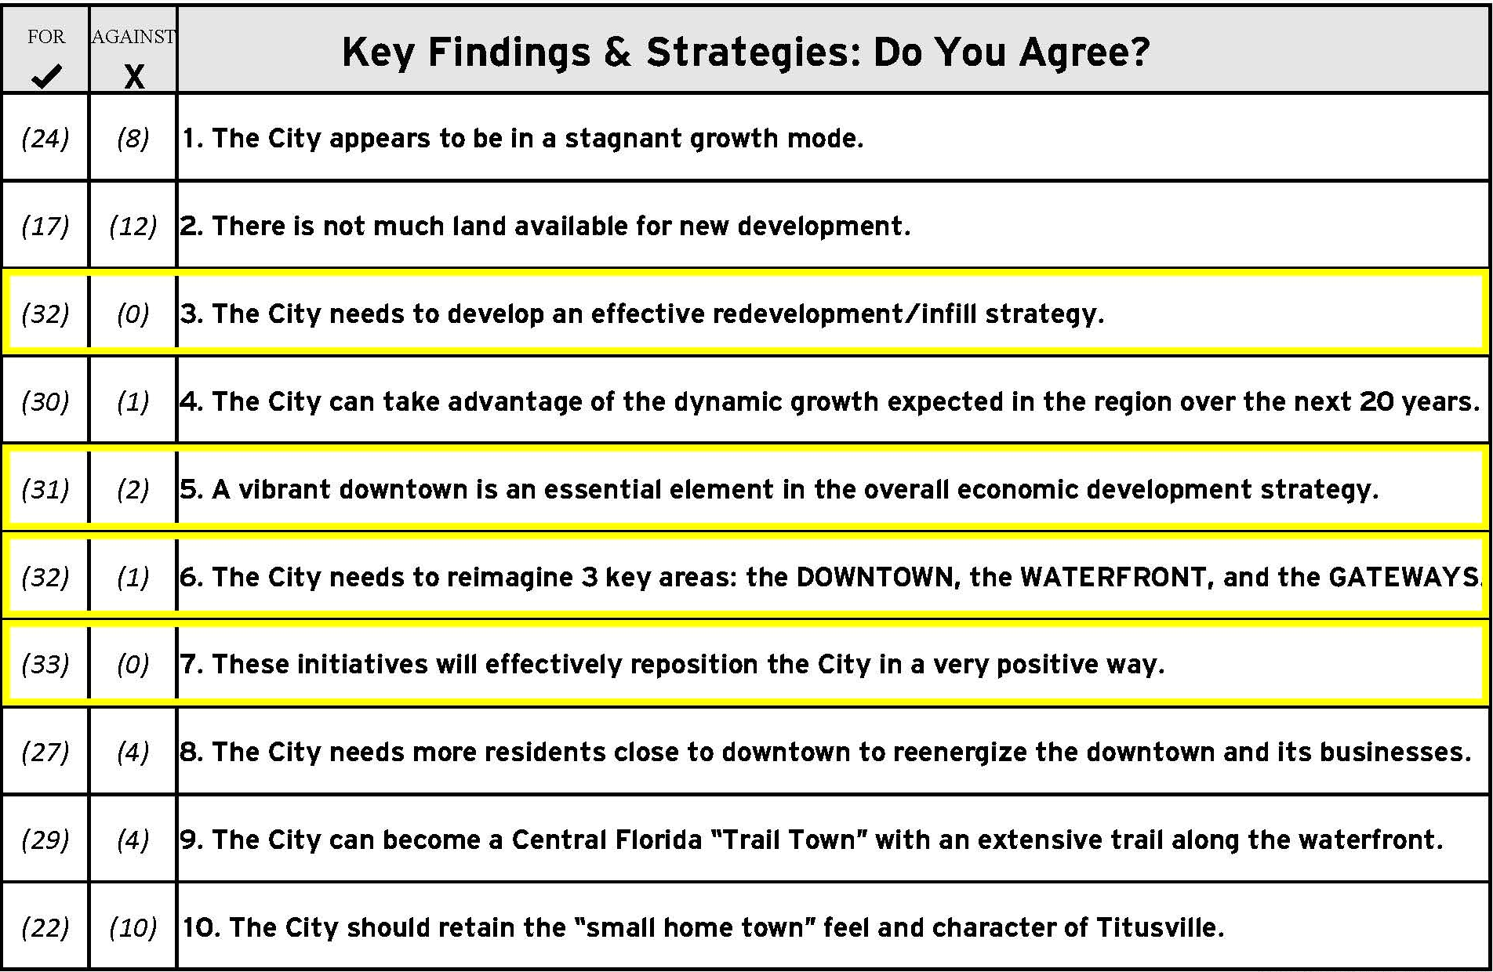
Key Findings & Strategies:

Slide 4


- Projects to Date
Project Background
Growth Estimates to 2040
- Current Plan Issues
- titusvilletomorrow
Revised Comp Plan
- Introduction
- People
- Places / Mobility
- Housing
- Natural Resources
- Public Facilities
- Intergovernmental
- Implementation
Notes:
Following medium projections, population estimates are approximately 66,000 residents.
When looking at the Comprehensive Plan, the goal is to accommodate the projected growth while meeting the other goals of the City.

Slide 5
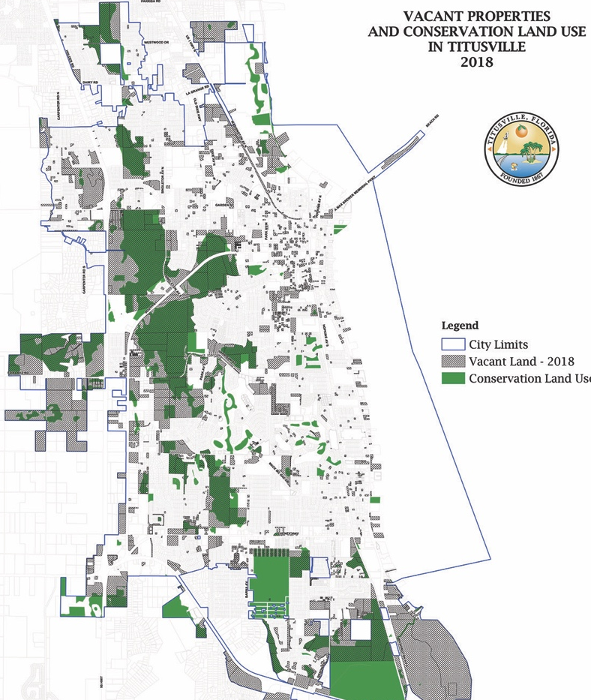
Project background
Project Background
Long
Term
Outlook
- Current Plan Issues
- titusvilletomorrow
Revised Comp Plan
- Introduction
- People
- Places / Mobility
Growth Constraints
Redevelopment Opportunities
- Housing
- Natural Resources
- Public Facilities
- Intergovernmental
- Implementation
Notes:
It is difficult to accommodate growth using the current plan. The projected growth cannot use all of the marginal lands and the commercial land uses prohibit residential.
City continues to accept long distance roads and water/sewer infrastructure in new subdivisions. Marginal lands are what is left to develop on but not well protected. Clustered development reduces the City’s liability and conserves land.
Clustered development allows for the lands with wetlands to accommodate development, while protecting wetland and other environmentally sensitive areas.

Slide 6
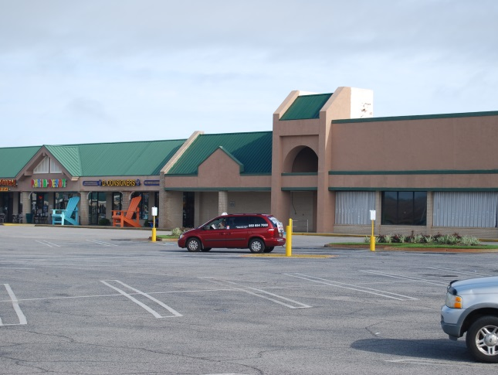
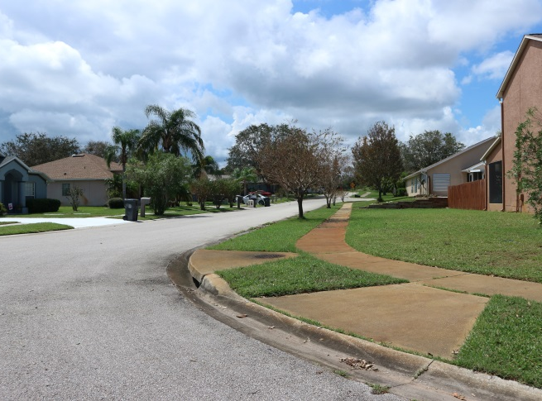
Current Plan Issues
Project Background
Key Issues
- Current Plan Issues
Population growth
Marginal lands
Exclusionary zoning
Retail vacancy
High parking and setback standards
- titusvilletomorrow
Revised Comp Plan
- Introduction
- People
- Places / Mobility
- Housing
- Natural Resources
- Public Facilities
- Intergovernmental
- Implementation
Notes:
Separate residential and commercial land uses leads to dependence on the automobile and expensive road infrastructure. Continued roadway capacity improvements to accommodate new development is expensive. Multiple driveways and wide roadways are dangerous for pedestrians.

Slide 7
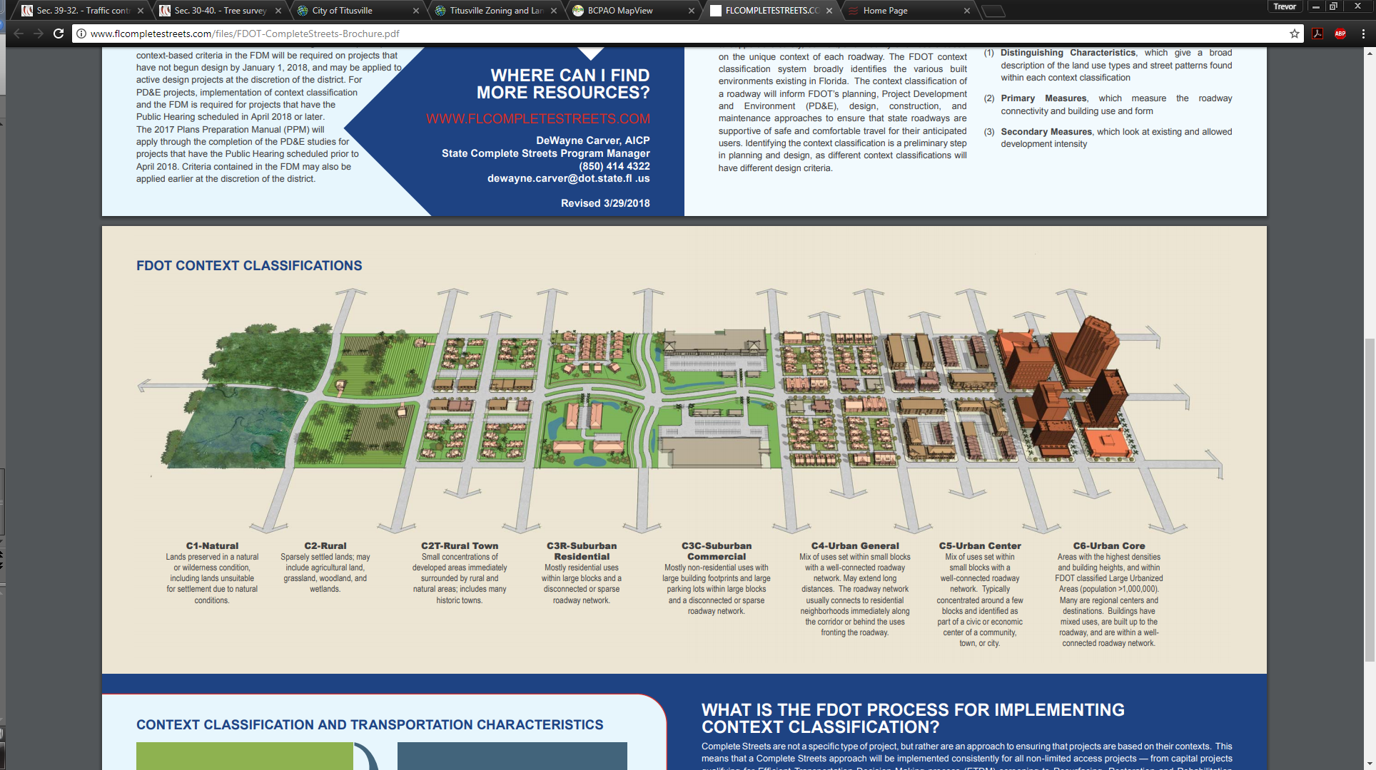
FDOT Context Sensitive Classifications
Notes:
FDOT is now looking at corridors holistically, taking into account the development typologies and the roadway conditions, rather than only the characteristics of the roadway. FDOT will look to the local plan and program improvements accordingly if these concepts are within the City’s Comprehensive Plan. In general, the corridors throughout the City fall between the C3R and C-5 transects.

Slide 8
Encouraged by Current Plan / Highly Limited by Current Plan
Discouraged by Revised Plan
Encouraged by
Revised Plan
Encouraged by
Current Plan
Highly Limited by
Current Plan
Notes:
C3R and C3C – large blocks, disconnected roadway network, large building footprints with large parking lots. Limiting to pedestrians, wholly automobile oriented.
C4 and C5 – smaller blocks, allows good connection between corridors and surrounding neighborhoods. Allows smaller commercial uses in walkable settings to serve surrounding developments. Also accommodates a mix of uses including residential and non-residential uses on one property

Slide 9
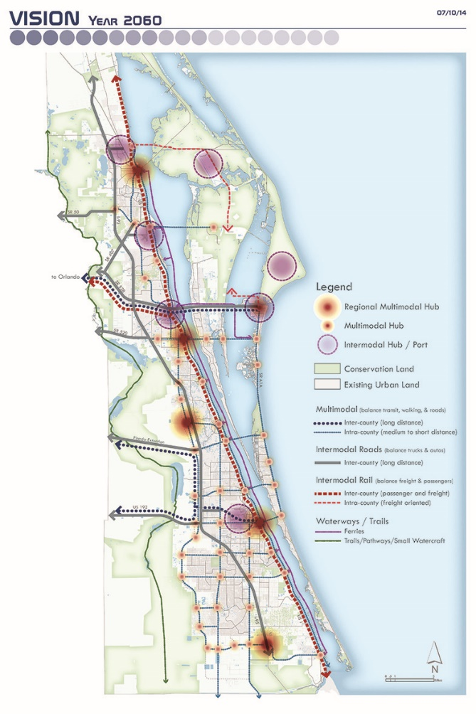
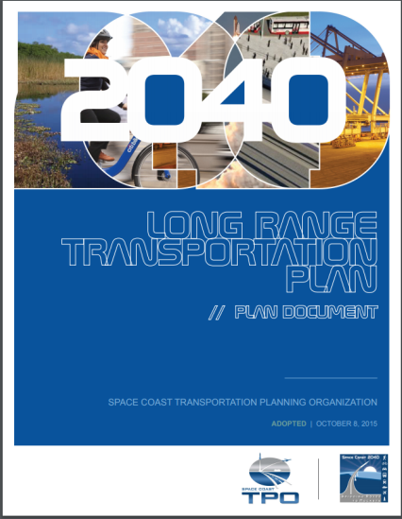
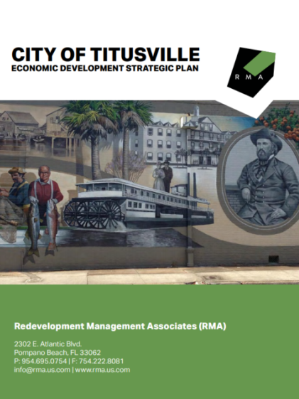
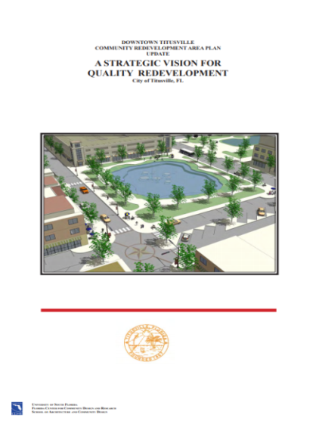
Revised Comp Plan
Project Background
Consistency with Long-term Plans
- Current Plan Issues
Space Coast TPO
- titusvilletomorrow
Revised Comp Plan
Economic Development Strategic Plan
- Introduction
- People
CRA Downtown Master Plan
- Places / Mobility
- Housing
- Natural Resources
Various City Master Plans and Small Area Plans
- Public Facilities
- Intergovernmental
- Implementation
Notes:
In addition to the titusvilletomorrow visioning exercise, plans from multiple agencies were referenced to ensure the revised plan is consistent with long term goals of other agencies within the County.
SCTPO LRTP – Strategizes scenarios based on mixed-use land use patterns and the corresponding impacts to the transportation network.
Econ Dev Strategic Plan – efficient and predictable LDRs, focusing on revitalization of the corridors, and long-term development strategies.

Slide 10
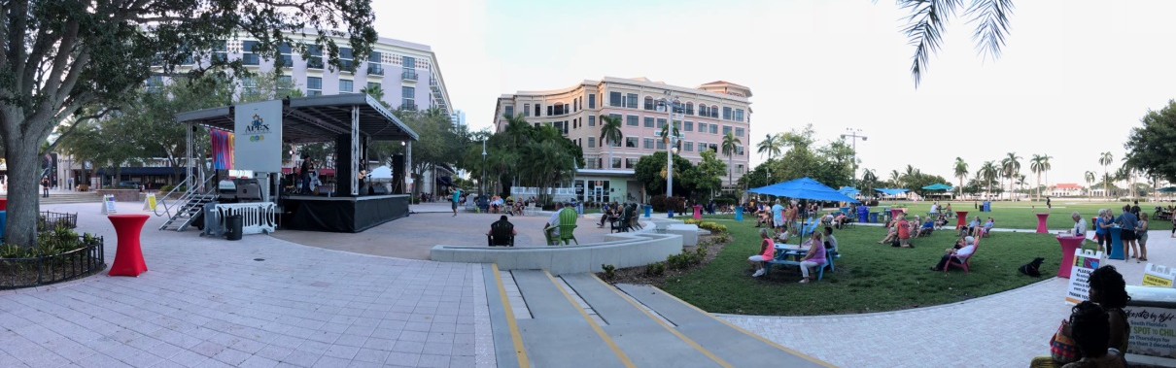
Introduction
Project Background
Titusville Comprehensive Plan Vision
“Unified by its natural features and space heritage, Titusville seeks to protect its future by: sustaining and nurturing a pedestrian scale and feel; protecting its’ waterfront and capitalizing on the opportunity to provide public access and enjoyment; utilizing smart-growth policies to accommodate future development, while protecting natural resources; and embracing the designation as a Trail Town by expanding pedestrian and bicycle infrastructure, and providing additional forms of mobility for residents and visitors.”
- Current Plan Issues
- titusvilletomorrow
Revised Comp Plan
- Introduction
- People
- Places / Mobility
- Housing
- Natural Resources
- Public Facilities
- Intergovernmental
- Implementation
Notes:
This is the goal of how the City will look at the end of the planning horizon, which is 2040.

Slide 11
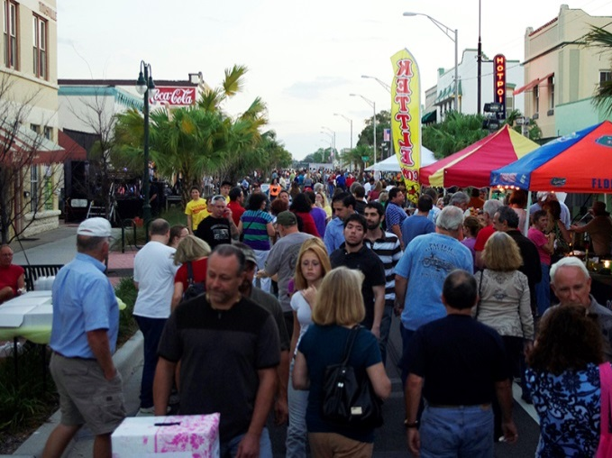
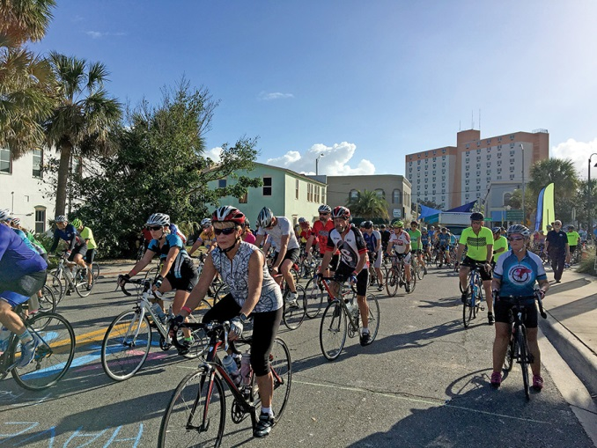
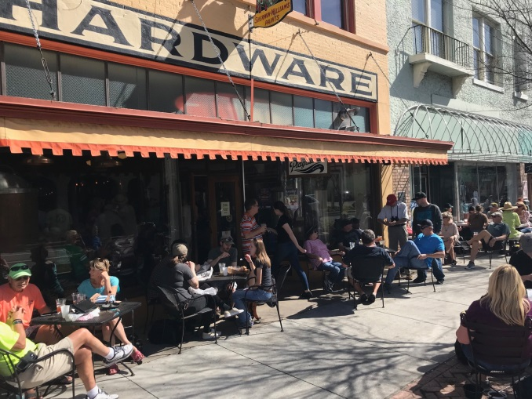
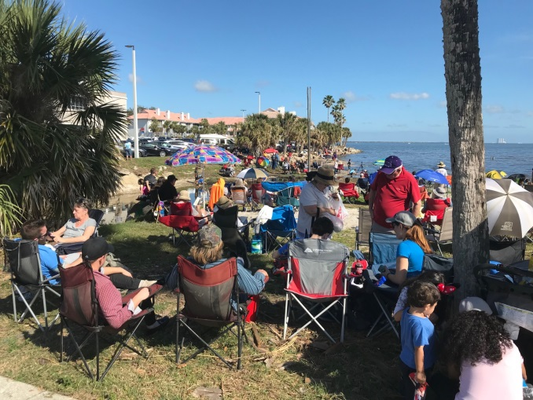
People
Project Background
- Current Plan Issues
- titusvilletomorrow
Revised Comp Plan
- Introduction
- People
- Places / Mobility
- Housing
- Natural Resources
- Public Facilities
- Intergovernmental
- Implementation
Notes:
Describes the City including demographics, housing, infrastructure, and integration of land use and mobility.

Slide 12
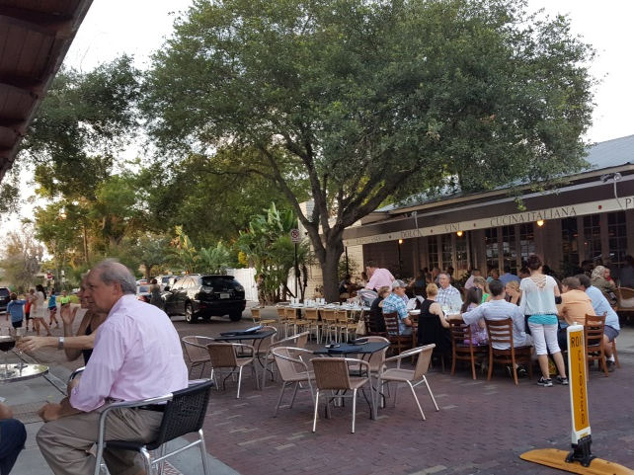
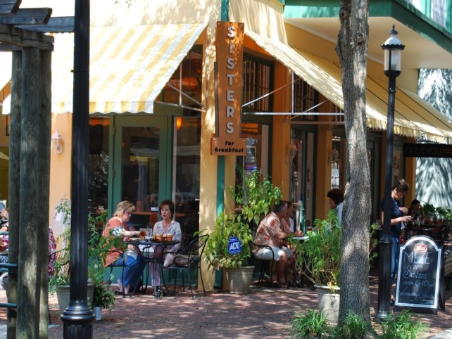
Places / Mobility
Project Background
Placemaking
Includes land use policies to implement the titusvilletomorrow vision
Policies that promote a built environment that creates a memorable experience for residents and visitors
- Current Plan Issues
- titusvilletomorrow
Revised Comp Plan
- Introduction
- People
- Places / Mobility
- Housing
- Natural Resources
- Public Facilities
- Intergovernmental
- Implementation
Notes:
Promotes a mix of uses, options for housing, entertainment, and employment

Slide 13
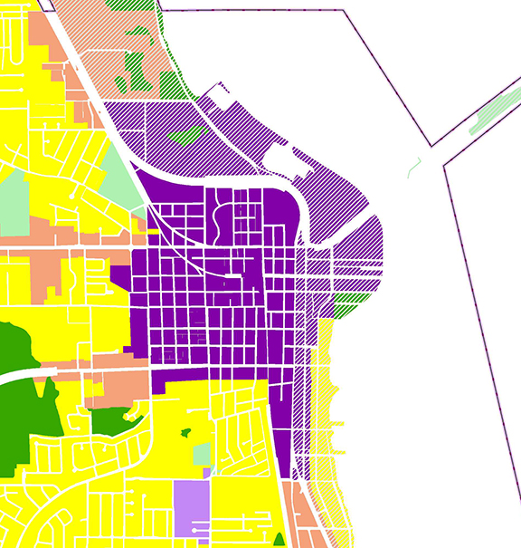
Downtown (D) Land Use
Downtown (D) Land Use
Promotes Mixed-use
Provides design guidance
Places emphasis on pedestrians/bicycles
Core – Secondary Area

Slide 14
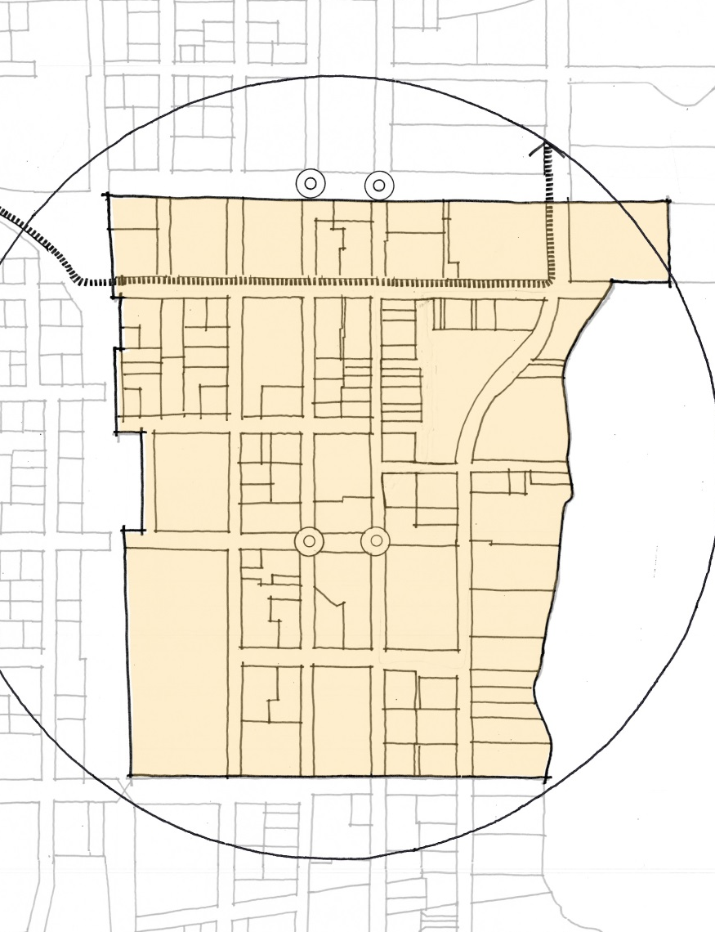
Downtown (D) Land Uses
Downtown (D) Land Use
Traditional street grid
Create a memorable identity
Encourages multiple types of residential
CORE

Slide 15
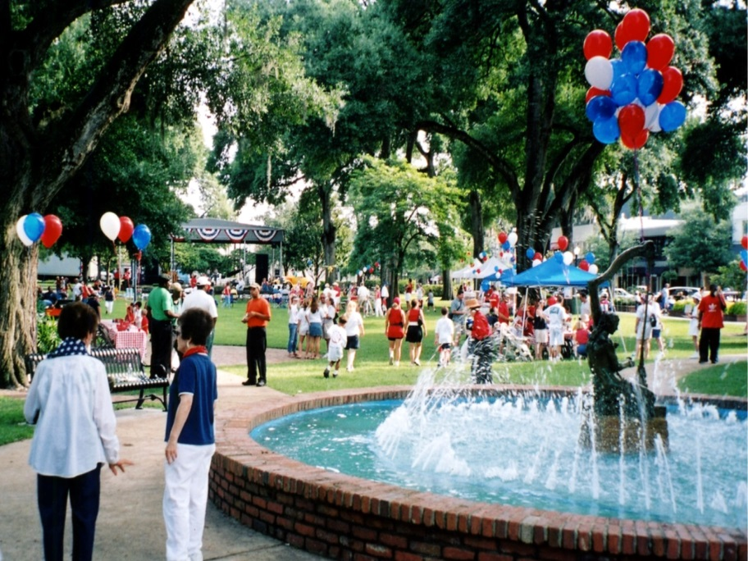

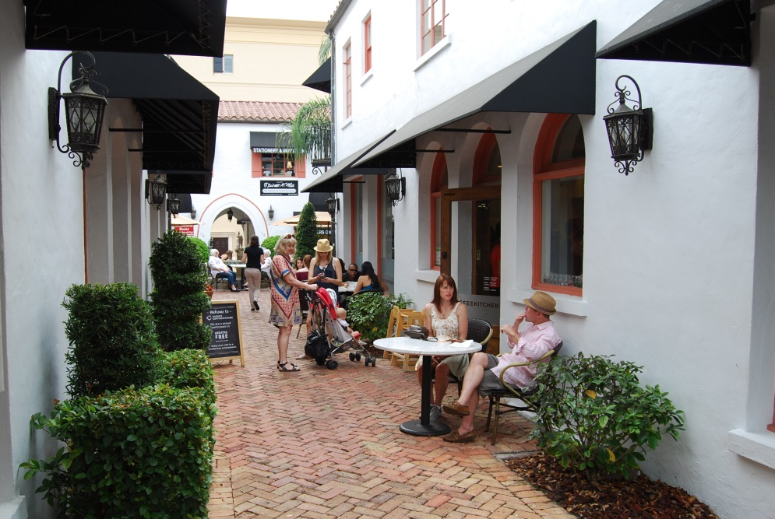
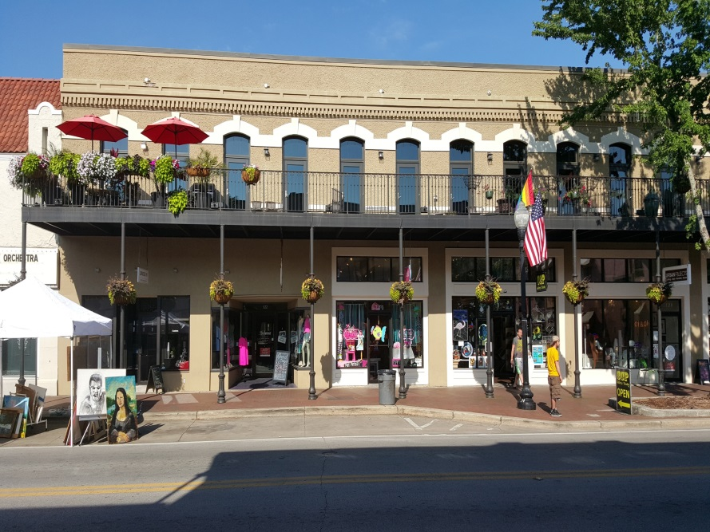
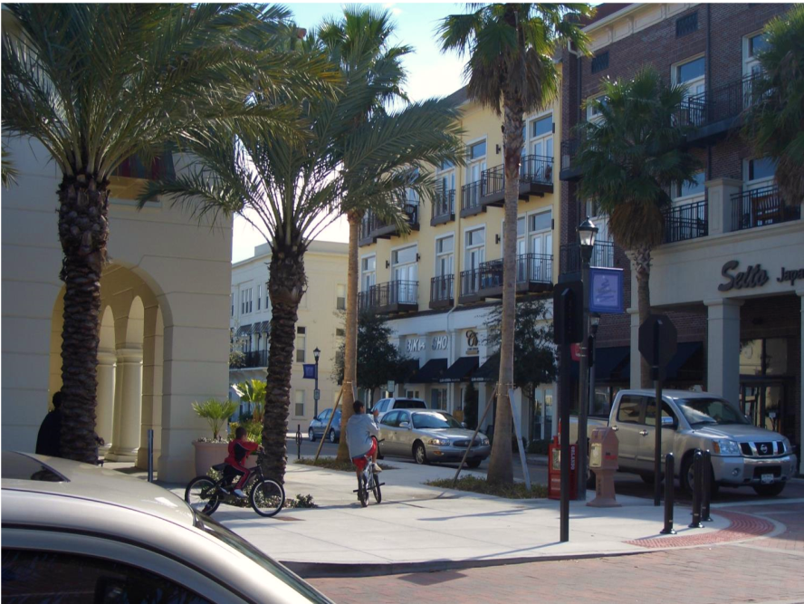
Downtown (D) Land Use Character Images
Downtown (D) Land Use Character Images
Notes:
The Downtown (D) land use encourages:
- Mixed use
- Pedestrian oriented buildings
- Location criteria for parking
- Encourages design standards/Form Based Code (FBC)

Slide 16
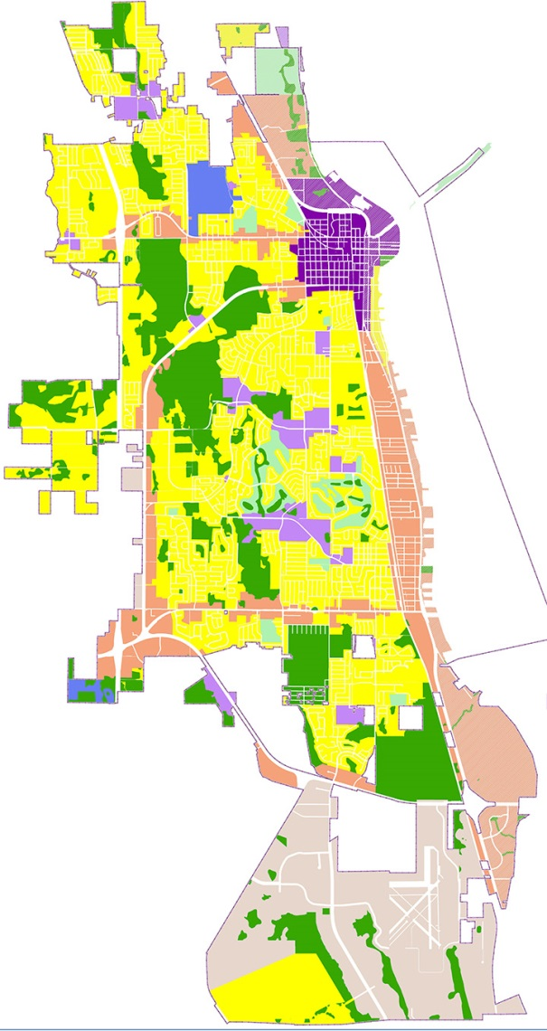
Gateway Corridor (GC) Land Use
Gateway Corridor (GC) Land Use
Promotes Mixed-use
Provides design guidance
Encourages multimodal transportation options
Designed to enhance aesthetics
Garden Street
Cheney Highway
Notes:
The revised place-based plan categories are intended to replace the existing single-use plan categories as described in CD Objective 1.8
Promotes mixed use
Establishes placemaking standards
Specifies preferred development typologies
Encourages a variety of mobility options.

Slide 17
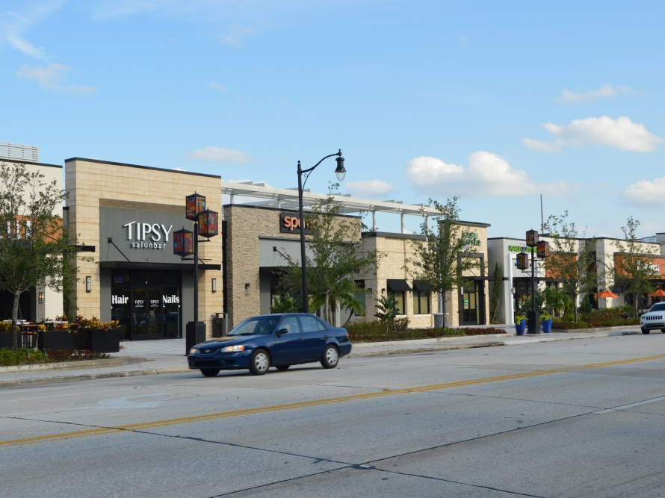
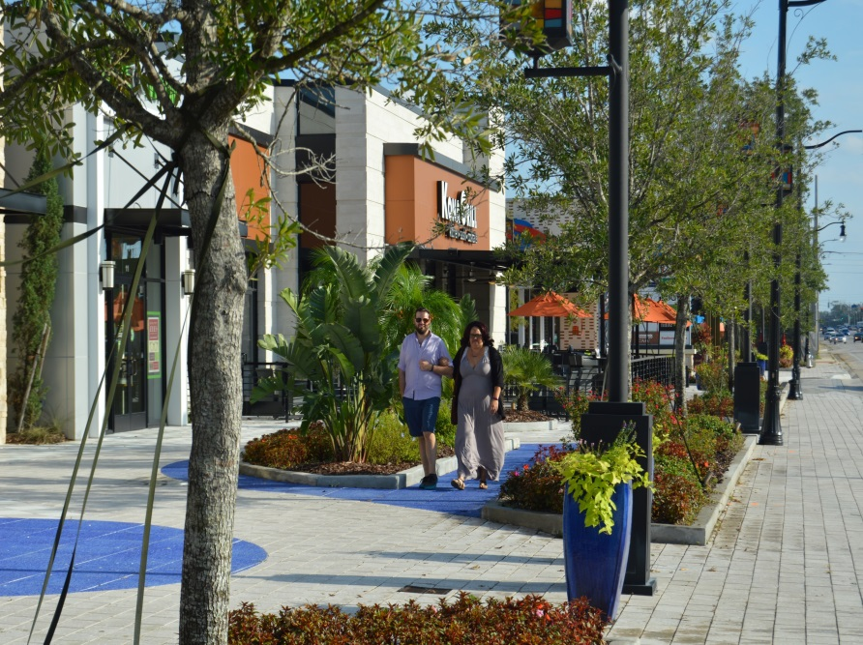
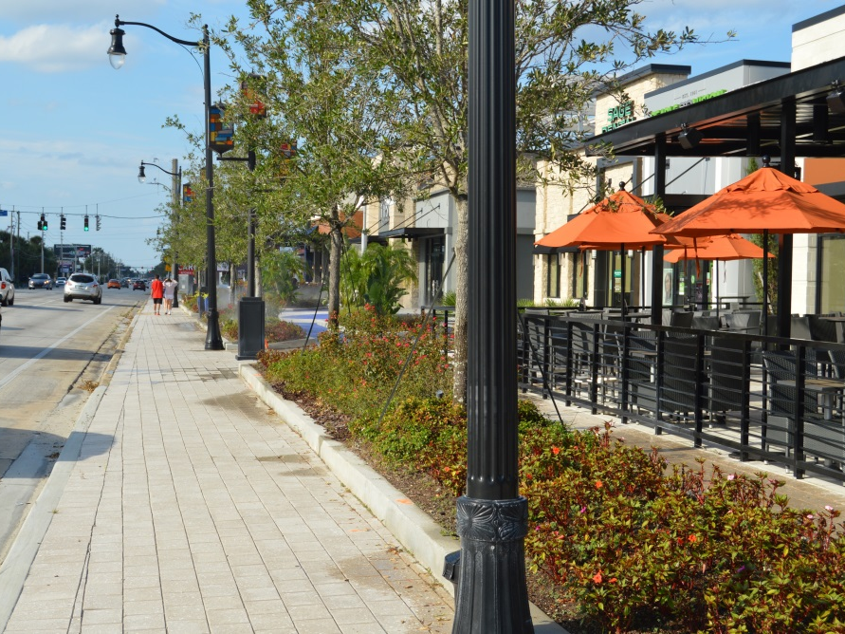
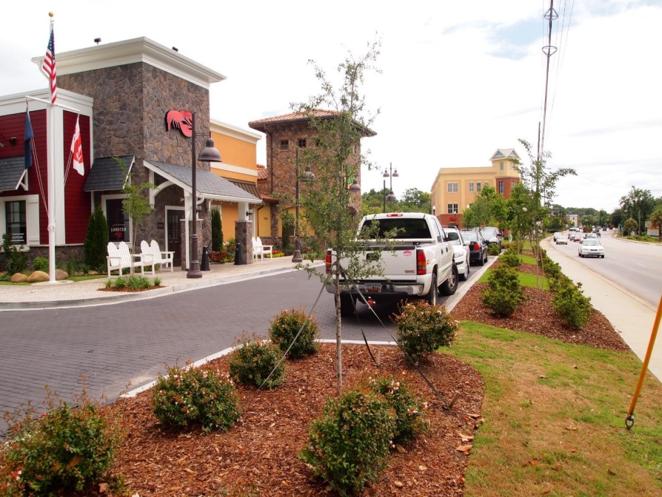
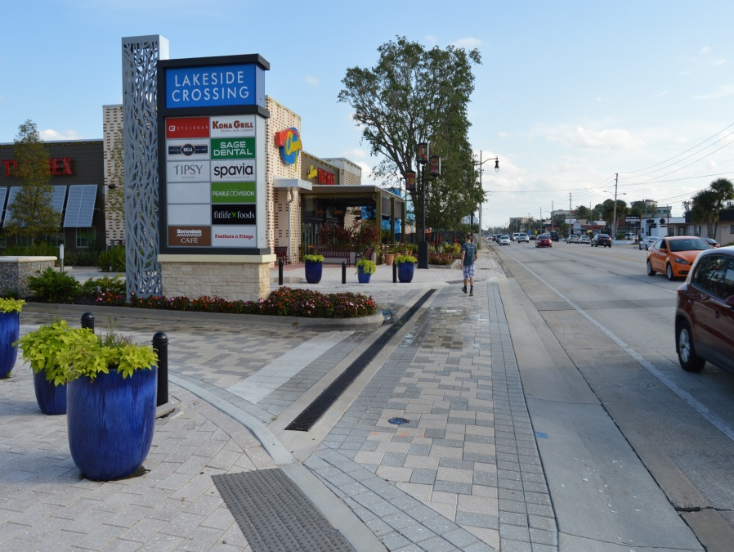
Gateway Corridor Land Use Character Images
Gateway Corridor (GC) Land Use Character Images

Slide 18
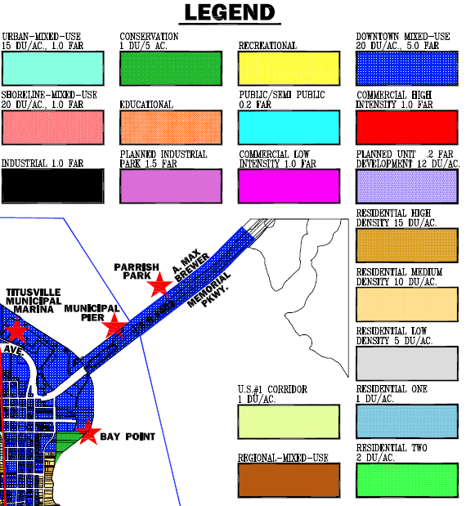
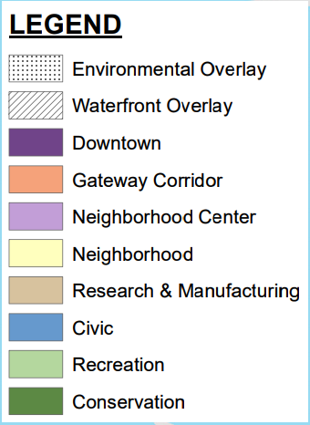
Revised Plan Categories
Project Background
Revised Plan Categories
- Current Plan Issues
Revised Plan:
8 Districts
1 Overlay
Existing:
19 Districts
- titusvilletomorrow
Revised Comp Plan
- Introduction
- People
- Places / Mobility
- Housing
- Natural Resources
- Public Facilities
- Intergovernmental
- Implementation
Notes:
It is difficult to redevelop properties under the current plan. Single use land uses on the commercial corridors leads to flip/flop comp plan land use amendments. This creates uncertainty. The Gateway Corridor land use category allows mixed use residential/commercial in one development. No need for flip/flop land use amendments as long as certain development design standards are followed. This creates certainty.

Slide 19
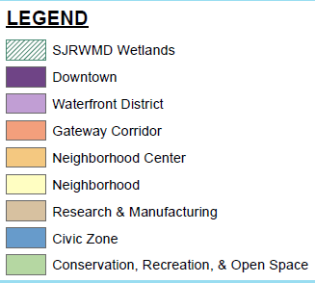
Places/Mobility
Project Background
Revised Plan Categories
- Current Plan Issues
Existing:
Revised Plan:
- titusvilletomorrow
Downtown MU
Urban MU
Commercial High
Commercial Low
Residential High
Residential Medium
Revised Comp Plan
- Introduction
- People
Downtown
- Places / Mobility
- Housing
- Natural Resources
- Public Facilities
- Intergovernmental
- Implementation

Slide 20

Neighborhood Land Use
Existing:
Revised Plan:
Neighborhood Land Use
High Density Residential
Medium Density Residential
Low Density Residential
Residential Two
Residential One
15 du/ac
10 du/ac
5 du/ac
2 du/ac
1 du/ac
AND
Density Frozen Based on Existing FLUM

Slide 21
Research & Manufacturing
Existing:
Revised Plan:
Industrial
Planned Industrial Park
Public/Semi-Public
Commercial High Intensity

Slide 22
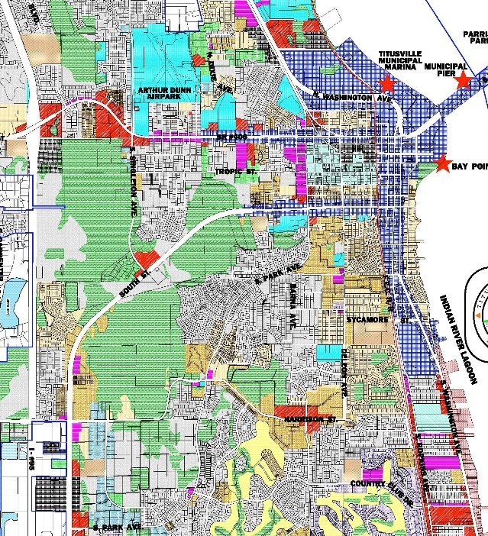
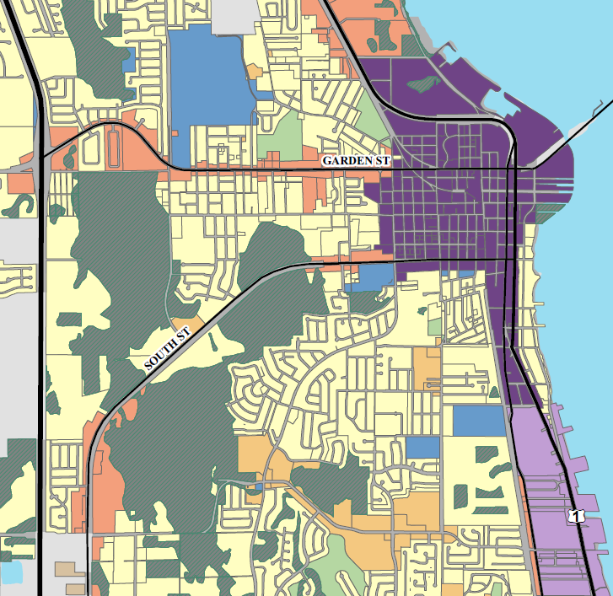
Revised Plan Categories Existing / Revised Plan
Project Background
Revised Plan Categories
- Current Plan Issues
Existing:
Revised Plan:
- titusvilletomorrow
Revised Comp Plan
- Introduction
- People
- Places / Mobility
- Housing
- Natural Resources
- Public Facilities
- Intergovernmental
- Implementation
Notes:
consolidating the land use categories reduces the need for amendments with every development proposal. Streamlines the approval process.
Increases readability by the general public, and other novice users of the plan.

Slide 23
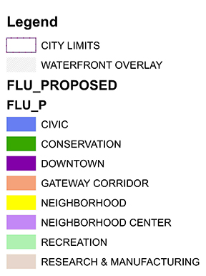
Revised FLUM
Project Background
Revised
FLUM
- Current Plan Issues
- titusvilletomorrow
Revised Comp Plan
- Introduction
- People
- Places / Mobility
- Housing
- Natural Resources
- Public Facilities
- Intergovernmental
- Implementation
Notes:
The revised place-based plan categories are intended to replace the existing single-use plan categories as described in CD Objective 1.8
Promotes mixed use
Establishes placemaking standards
Specifies preferred development typologies
Encourages a variety of mobility options.
Yellow = freeze density.

Slide 24
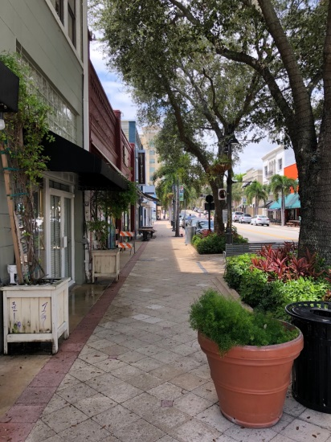
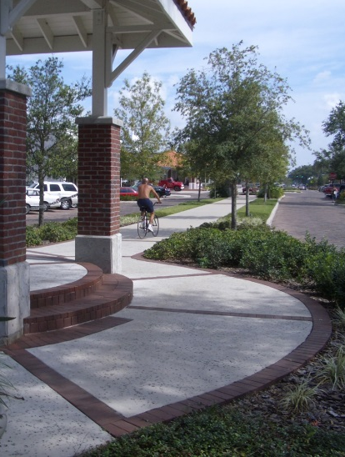
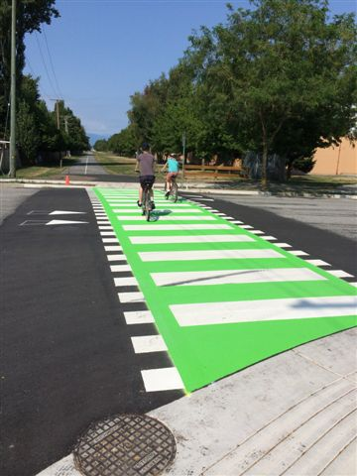
Mobility
Project Background
Mobility
Encourages multimodal approaches to mobility improvements
- Current Plan Issues
- titusvilletomorrow
Establishes policy to create a mobility master plan
Revised Comp Plan
- Introduction
- People
Source: Richmond, BC
- Places / Mobility
- Housing
- Natural Resources
- Public Facilities
- Intergovernmental
- Implementation

Slide 25
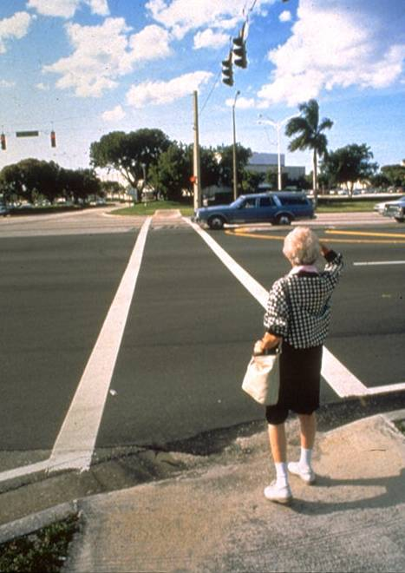
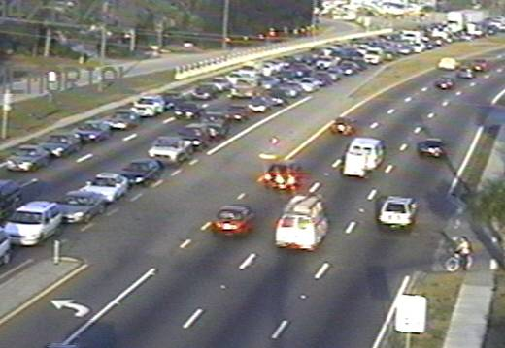
How Wide is Wide Enough?
Notes:
Besides, how wide is wide enough?

Slide 26
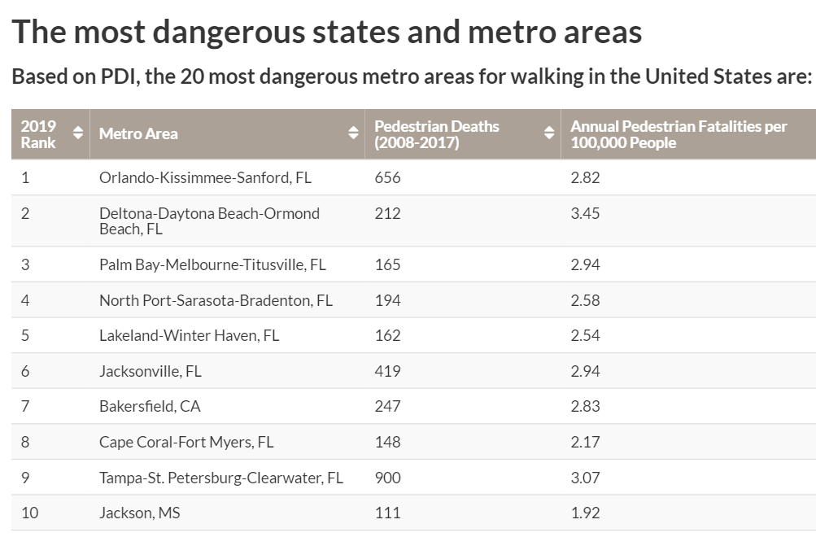

Dangerous by Design
Notes:
Need a long term approach to reverse this trend.

Slide 27
Approach: Expand Options
Shift transportation system emphasis so more modes are viable, desirable choices
Support mixed use & higher densities in key nodes or corridors
Connect the nodes with transit
Improve walking conditions throughout
Create a network of cycling routes
Expand local street connections as redevelopment occurs
Notes:
Land Use and Transportation are not mutually exclusive. Half of the new plan addresses the relationship between land use and transportation.

Slide 28



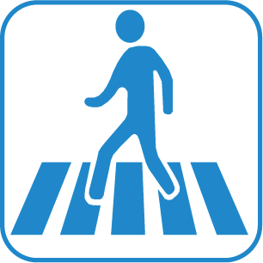


Transportation Level of Service
Transportation Element is now Mobility
No change to Arterial/Collector Level of Service
Added new multimodal policies.
Added more Complete Street policies
Added block perimeter policies
(Downtown minimum blocks per square mile)
Added more access management policies
Notes:
We recommended the following in the new comp plan. Golf cart crossing was added at the request of Councilman Jordan.
Parking is something that we should evaluate. We have the highest multifamily residential ratio requirements in the County. Creates a lot of underutilized parking. Some use ratios might need to be increased.

Slide 29
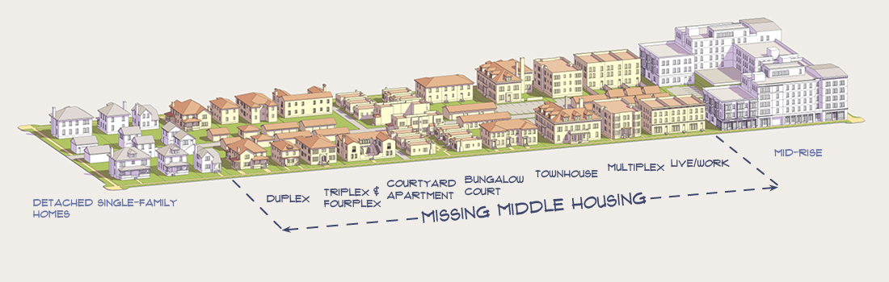
Housing
Project Background
Housing
Addresses affordable housing
Encourages preservation and re-use of historic homes
Establishes preferred housing typologies
- Current Plan Issues
- titusvilletomorrow
Revised Comp Plan
- Introduction
- People
- Places / Mobility
- Housing
- Natural Resources
- Public Facilities
- Intergovernmental
- Implementation
Notes:
Provides options for establishing additional affordable housing policies and/or programs.

Slide 30
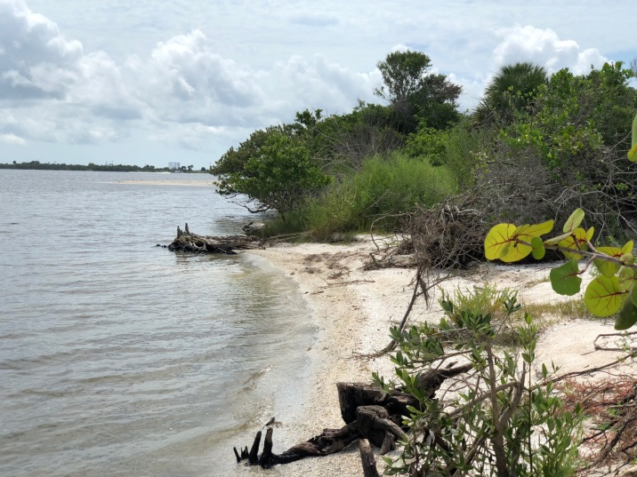
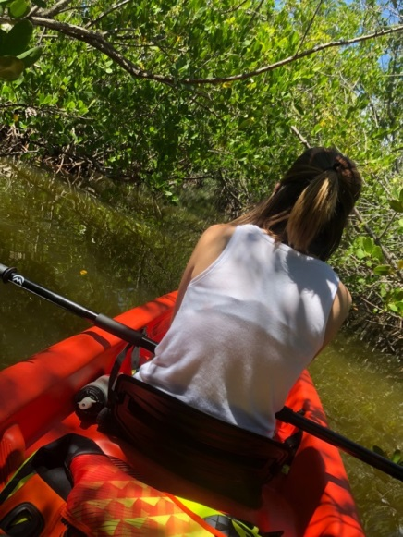
Natural Resources
Project Background
Natural Resources
Describes the goals of the City as they relate to natural resources in two parts.
A. Open Space
B. Environmental
- Current Plan Issues
- titusvilletomorrow
Revised Comp Plan
- Introduction
- People
- Places / Mobility
- Housing
- Natural Resources
- Public Facilities
- Intergovernmental
- Implementation
Notes:
A. Open space – relates to the provision of open space, how to rank property for acquisition if necessary, establishes policies on what types of open space are appropriate, and where.
B. Policies pertaining to protection of natural resources, policies related to natural vegetation and trees, protection of endangered species, establishes procedures to amend the FLUM as it relates to wetlands areas.

Slide 31
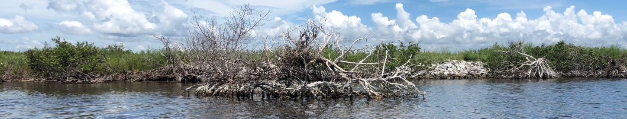
Conservation Land Use and Wetlands
Project Background
Conservation Land Use and Wetlands
- Current Plan Issues
EN Goal 2: Protect those areas determined to be wetlands.
- Sets policies for identifying wetlands
Sets allowable methods of preserving wetlands
Sets procedures on how to amend the Conservation (CNS) land use plan category on the FLUM
- titusvilletomorrow
Revised Comp Plan
- Introduction
- People
- Places / Mobility
- Housing
- Natural Resources
- Public Facilities
- Intergovernmental
- Implementation
Notes:
>5 ACRE WETLANDS PRESERVED IN ST. JOHNS EASEMENT OR CONSERVATION LAND USE.

Slide 32
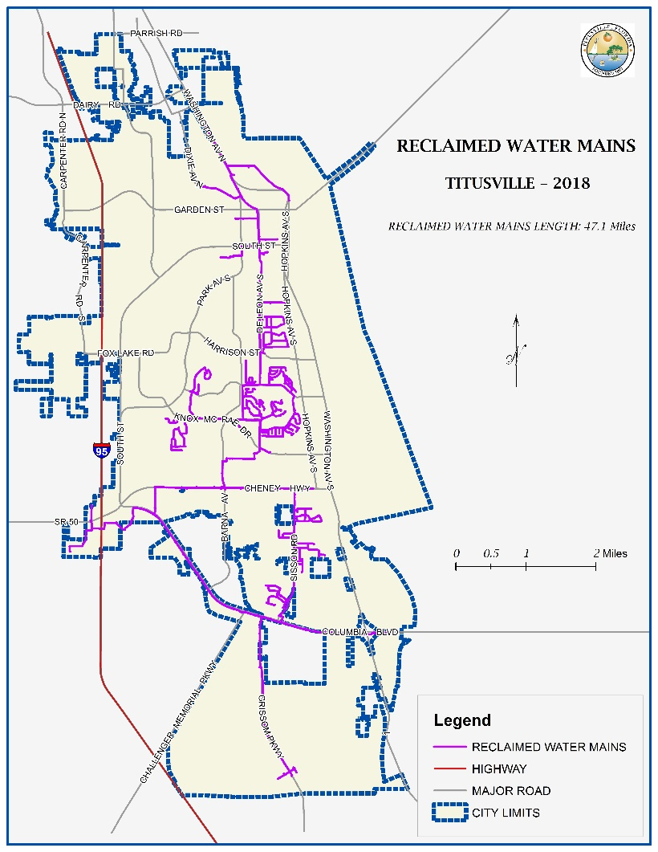
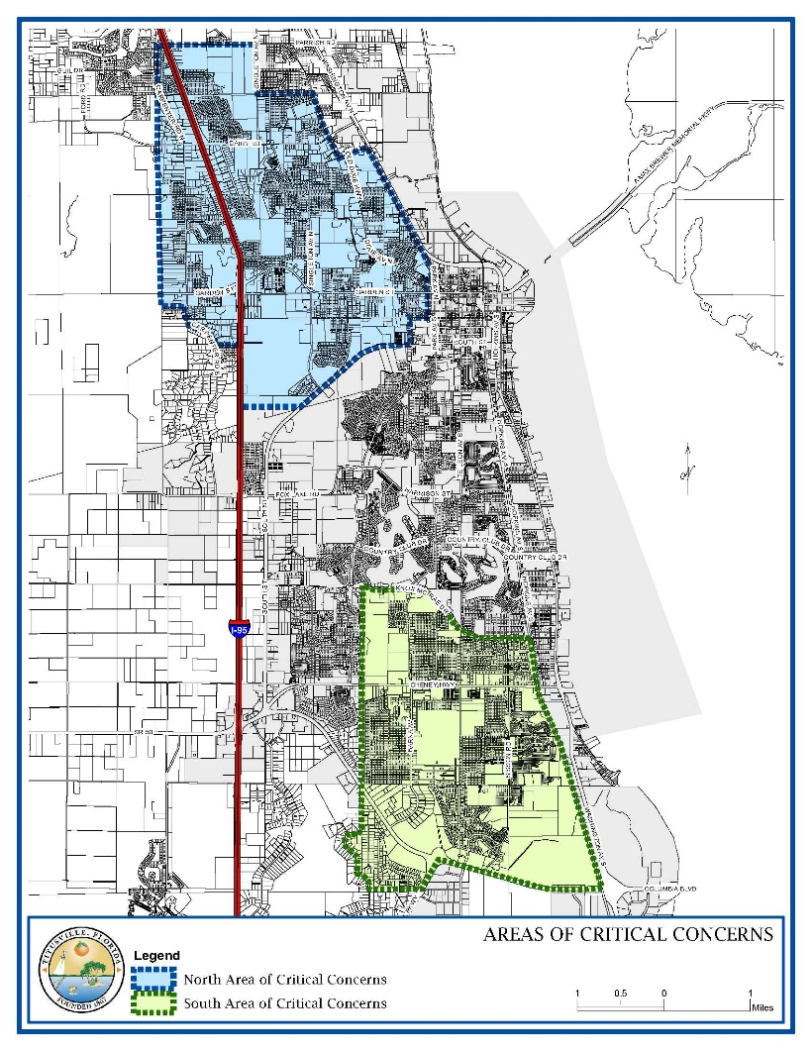
Public Facilities
Project Background
Public Facilities
- Current Plan Issues
Mobility
Potable Water and Sewer
Stormwater
Solid Waste
Schools
Capital Improvements
Concurrency
(Level of Service)
- titusvilletomorrow
Revised Comp Plan
- Introduction
- People
- Places / Mobility
- Housing
- Natural Resources
- Public Facilities
- Intergovernmental
- Implementation

Slide 33
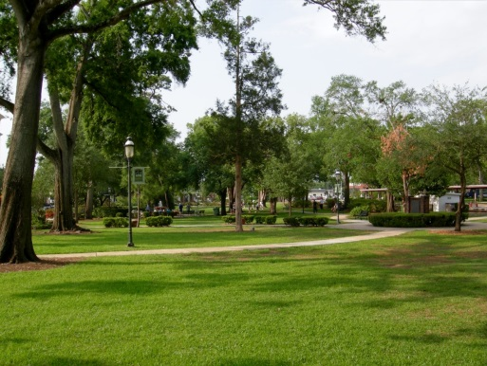
Concurrency (Level of Service)
Project Background
Concurrency (Level of Service)
Establishes acceptable capacities at which public facilities are provided
Transportation level of service includes:
- Current Plan Issues
- titusvilletomorrow
Revised Comp Plan
- Introduction
- People
- Places / Mobility
- Housing
- Natural Resources
Parks level of service based on proximity to residential.
e.g. small park within ¼ mile walk
- Public Facilities
- Intergovernmental
- Implementation

Slide 34

Public Parks in Titusville 2018
Parks Level of Service
8 acres/1,000 persons
Population 47,571
Required 380 acres
Current 706 acres

Slide 35

Level of Service Analysis Parks City of Titusville 2018-2040

Slide 36
New Parks Level of Service
Based on proximity to residential.
e.g. small park within ¼ mile walk
Enables new park and open space criteria to be adopted into the LDRs
Notes:
The new criteria might address pocket parks, civic parks, recreation amenities in new subdivisions. The intent is to create new recreation opportunities through private development rather than public expenditure.

Slide 37

Intergovernmental Coordination
Project Background
- Current Plan Issues
Utility Service
Area
- titusvilletomorrow
Revised Comp Plan
- Introduction
- People
- Places / Mobility
- Housing
- Natural Resources
- Public Facilities
Intergovernmental Coordination
- Intergovernmental
- Implementation

Slide 38

Implementation Matrix
Project Background
Implementation Matrix
- Current Plan Issues
- titusvilletomorrow
Revised Comp Plan
- Introduction
- People
- Places / Mobility
- Housing
- Natural Resources
- Public Facilities
- Intergovernmental
- Implementation

Slide 39


Implementation Key Strategies
Project Background
Key Strategies
New Development Design Standards
Building orientation, frontage standards and access management
Multimodal Master Plan
Recreation and Open Space Master Plan
Resiliency Strategic Plan
Addresses Flooding due to Sea-level rise
Update the Waterfront Master Plan
- Current Plan Issues
- titusvilletomorrow
Revised Comp Plan
- Introduction
- People
- Places / Mobility
- Housing
- Natural Resources
- Public Facilities
- Intergovernmental
- Implementation
Notes:
Strategies currently being undertaken include the Multimodal Master Plan, and the Resiliency Strategic Plan (Resilient Titusville)

Slide 40
Implementation Key Strategies Continued
Project Background
Key Strategies
Develop Neighborhood Plans to guide land use and development decisions
Current examples
Riveredge Drive Small Area Plan 2004
Indian River City Neighborhood 2012
South Street Small Area Plan 2015
Adoption Strategy
Adopt New Land Uses Categories
- Current Plan Issues
- titusvilletomorrow
Revised Comp Plan
- Introduction
- People
- Places / Mobility
- Housing
- Natural Resources
- Public Facilities
- Intergovernmental
- Implementation
Notes:
Neighborhood plans can address appropriate locations for development types, height, massing, and types of uses.

Slide 41

Planned Development Zoning District (PD) Zoning
Notes:
To help facilitate implementation an updated PD ordinance with mixed use standards should be adopted.

Slide 42
Titusvilletomorrow Future Land Use Implmentation Scenarios
Notes:
Scenario 1: Triggered when a request requires a land use amendment.
Scenario 2: Triggered when a rezoning is required to allow a mixed use development.
Scenario 3: Public hearing is required for variances.

Slide 43

Transfer of Development Rights
Transfer residential units from one property to another
Transfer residential units from one portion of a property to another.

Slide 44

Sustainability
CD Obj. 1.5 Greenhouse emissions from development
Sustainable design
Compact development
Cluster subdivisions
Mixed Use
CM Policy 4.1.4 LID
Mobility GOPs

Slide 45
Questions?

